Slide 1
An ATT&CK Tactic Approach to Measuring Security and Risk
Michael Gorelik
Chief Technology Officer

Slide 2
Agenda
Intro to MITRE ATT&CK Framework
Technique Centric Defense
Tactic Centric Defense
Tactic Defense Technologies
Measuring Risk Against ATT&CK
Real-World Attack Example
Conclusion

Slide 3
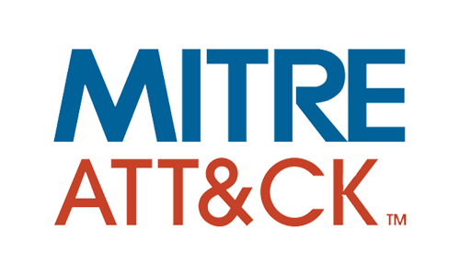
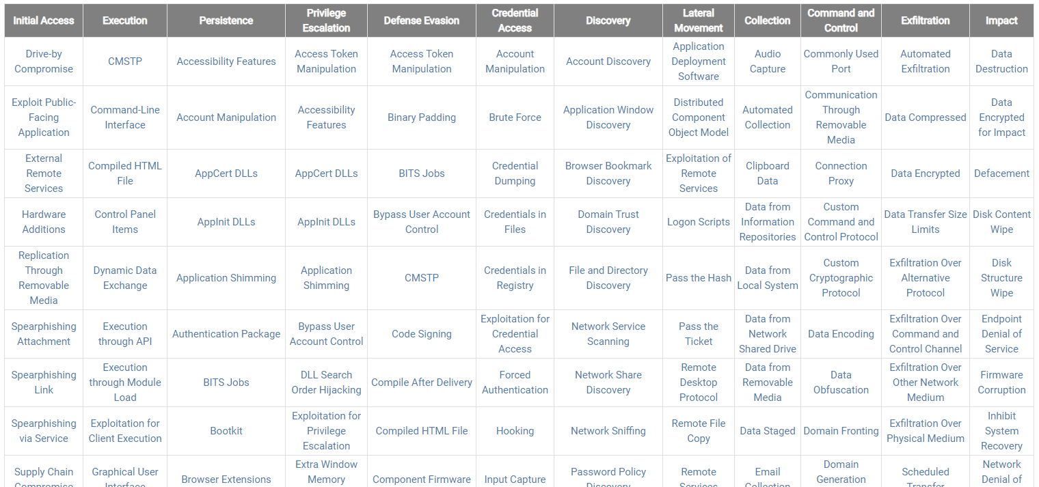
Intro to Framework
Globally accessible knowledge base of adversary tactics and techniques based on real-world observations of cyberattacks
Partial Enterprise ATT&CK matrix for Windows
Notes:
MITRE is a not-for-profit organization managing RnD centers for US government agencies (~8,000 employees)
ATT&CK is a small team within MITRE that focuses on cyberattacks (~15 employees)
Mitre is a non-profit organization that does work with private industry and the US government and their mission is to make the world to be a safer place, many of us knows them by the maintenance of the CVE list and the assigned vulnerability scores
Mitre Att&ck is consist from Pre-Att&ck, Att&ck and Mobile – filled from successful techniques previously identified to be used in the wild for a purpose of breaching an organization

Slide 4
Tactics and Techniques
Tactics short-term, adversary goals during an attack (column headings)
Eg: Initial Access
Security tools offer detection or prevention of techniques and tactics
Gaps in coverage help measure risk
Techniques means by which adversaries achieve tactical goals (individual cells)
Eg: Spearphishing Link
Notes:
New technique are added and identified constantly

Slide 5
Status Quo ATT@CK Strategy Technique Centric Defense
Most vendors focus on detecting adversarial Techniques
Technique Detection is the focus of MITRE Evaluations
Static and/or behavioral detection is required
One rule cannot detect a given technique 100% of the time
New techniques are added on a regular basis
Signatures, behavioral analysis, heuristics must react
Attackers change techniques to circumvent defenses
Defenses must address each technique individually
Technique detection coverage is a common way security teams assess risk
Alert severity associated with technique detections
Dwell time greatly increases organizational risk
Notes:
Chasing down techniques is like playing whack-a-mole. Businesses and vendors will continue to attempt to mitigate the specific techniques that they’ve seen exhibited by threat actors. However, these threat actors can change their technique or even create new ones (unknowns), and circumvent defenses. They do this without changing their tactic because they can’t change their tactic.
Analogy: If you want to break into a home (tactic) you can pick a lock, break a window, kick in a door, climb down the chimney (technique). In the end they can change how they try to get into the home to succeed in their mission, however, they can’t change their tactic and succeed.
Static, IoCs, and even behavioral-based focus on addressing techniques, not tactics. This makes it easy for adversaries to sidestep defenses.
Alert severity – MITRE does not measure what a solution does with a detection. If alert severity not appropriate to risk level then dwell time and risk can be high even if technique detected

Slide 6
Proposed ATT@CK Strategy Tactic Centric Defense
Prevent objectives (tactics) rather than detect methods (techniques)
The tactics of an APT do not change
A shift in prioritization
Prevent the Tactic then Detect Technique
Improved risk reduction and assessment
Prevention means zero dwell time
Tactics provide a more accurate measure
Less disruption, lower costs

Slide 7
Measuring Risk Against MITRE ATT&CK
Use Adversary Emulation Planning
Know the Tactics and Techniques of relevant threat actors
Map your current coverage to ATT&CK
Understand which Tactics and Techniques you prevent or detect
The differences between these are your areas of greatest risk exposure
Focusing on Tactics, not just Techniques helps reduce risk from unknowns
Preventing a Tactic will stop the rest of the chain
Eliminates the Impact on your business
Techniques & Tactics most used against your business
Current protection coverage
Where to focus new strategies and technologies
Notes:
MITRE has added a new Tactic, Impact, which relates to damage to the enterprise, but it is narrowly focused and does not consider the many other associated risks
Consider risk of false positives (missed attacks due to alert fatigue)
Consider risk of escalating costs

Slide 8
Tactic Defense Centric Technologies
Asset Hardening
Attack Surface Reduction (disabling functionality)
Moving Target Defense
Reduction of privilege escalation risk
Customer side: Microsoft Office 360
Vendor side: Disable VBscript/Powershell
Reduces exposure to number of tactics without detecting techniques
Notes:
Does anyone here use any of these technologies today?
These are not uncommon technologies, but their ability to prevent MITRE tactics is often not accounted for in risk analysis
All those in common , they do not rely on detection and therefore they are tactic centric

Slide 9
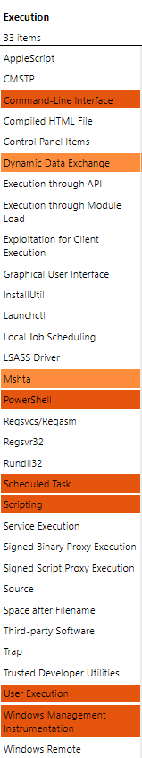
FIN7/8 and Attack Surface Reduction
FIN7/8 and ASR
Threat actors FIN7 and FIN8 are known to leverage several Techniques for Execution
Through ASR, business can reduce risk of Execution in their environment regardless of the Technique used

Slide 10
Trickbot and Asset Hardening
Software Packing
Trickbot is a commonly used malware platform that leverages 7 different techniques just for defense evasion
Through Asset Hardening, businesses can reduce risk of Trickbot successfully evading their defenses no matter the technique
Deobfuscate/ Decode Files or Information
Scripting
Defense Evasion
Process Injection
Disabling Security Tools
Obfuscated Files or Information
Modify Registry

Slide 11

CCleaner Backdoor and Moving Target Defense
The CCleaner backdoor enables adversaries to achieve Initial Access through the Supply Chain Compromise technique
The Supply Chain Compromise can take place at any stage of the supply chain so no one static or behavioral indicator can detect it
Moving Target Defense prevents CCleaner from achieving Initial Access despite the general technique it exhibits

Slide 12
Most people focus on detecting techniques
Tactic detection or even better, prevention, is the best way to reduce risk to the business
Techniques are important to understand only after the threat is contained
Requires new 3rd dimension to the framework: Risk Exposure score
Dwell time impact
Alert severity
Innovative technologies are focusing on tactic prevention
Data from prevention technologies can drive a feedback loop to detection technologies to make them more efficient and effective
Determine alert priority
Information on new techniques uncovered
Conclusion
Notes:
Prevention can drive feedback back to the detection solution

